Slide 1
GROUP_C_5

Slide 2
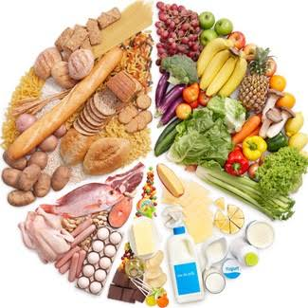
AMAZON BUSINESS RESEARCH ANALYST DATASET
Case in Study: Restaurant
Food is an essential need for man's survival.
Everyone of us at certain points has either had a best food or cravings for certain kinds of foods and would most likely go to any length to get it either by cooking or eating out. We also have ideal situations where the factors like the weather influences what we eat.
For example, certain people wouldn't order for a certain meal when the weather is bad, because they feel delivery guys wouldn't work, or movement might be impeded, or maybe such meals might affect their health. There are also days a restaurant gets to be patronized the most. This reality helped use define our objectives for the project.

Slide 3

AMAZON BUSINESS RESEARCH ANALYST DATASET
Case in Study: Restaurant
Objectives
What food customers like the most?
Does weather influence what people eat?
What is the preferred mode of transportation used by the restaurant?
What time do people pick their orders most?
Which days are the busiest in the restaurant [which days do customers visit the restaurant the most]?
6. Which days of the week does the restaurant delivers most patronize?
7. What is the relationship between the time taken to deliver food and the distance travelled?
8. What is the correlation between days of the week with respect to the type of vehicle used to deliver food and the distance covered]?

Slide 4
AMAZON BUSINESS RESEARCH ANALYST DATASET
Case in Study; Restaurant
Machine learning scenario:
Mrs Ndidi ordered meals at the amazon restaurant on Thursday morning. Predict how long before she received her order if the delivery man used motorcycle bearing in mind that the customer stays 9.760928 km away from the restaurant?
Models used:
Decision tree
Linear Regression

Slide 5
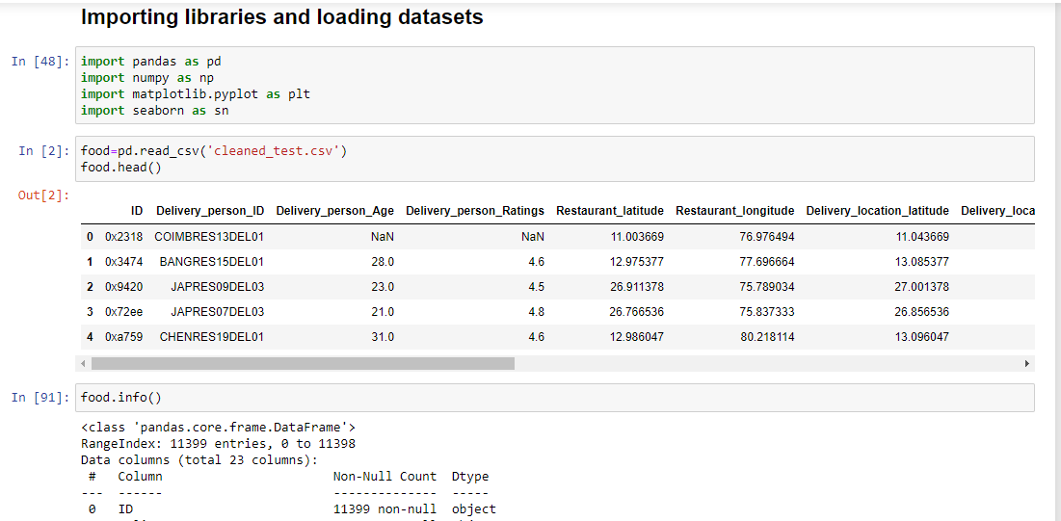
AMAZON BUSINESS RESEARCH ANALYST DATASET
Case in Study; Restaurant

Slide 6
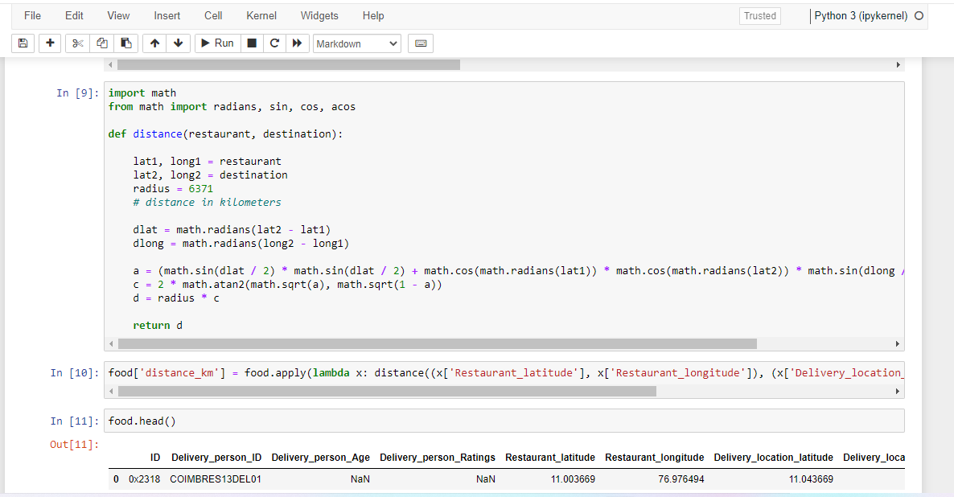
AMAZON BUSINESS RESEARCH ANALYST DATASET
Case in Study; Restaurant

Slide 7
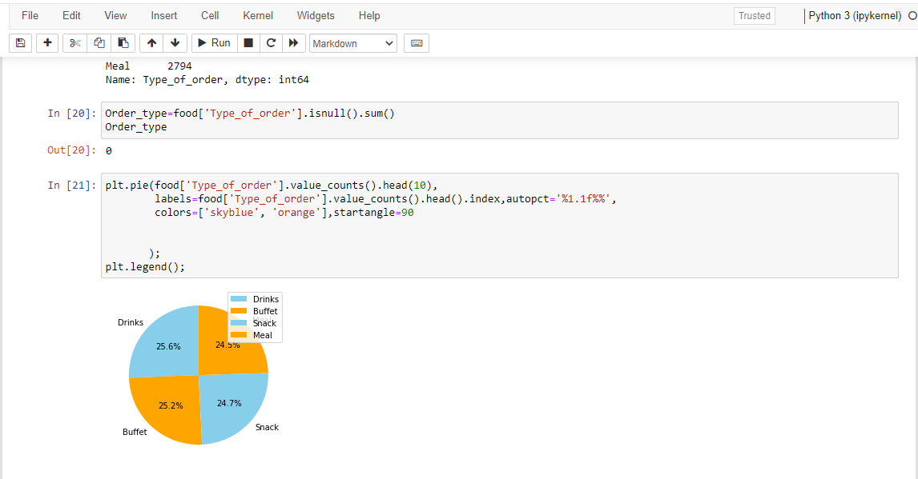
AMAZON BUSINESS RESEARCH ANALYST DATASET
Case in Study; Restaurant

Slide 8
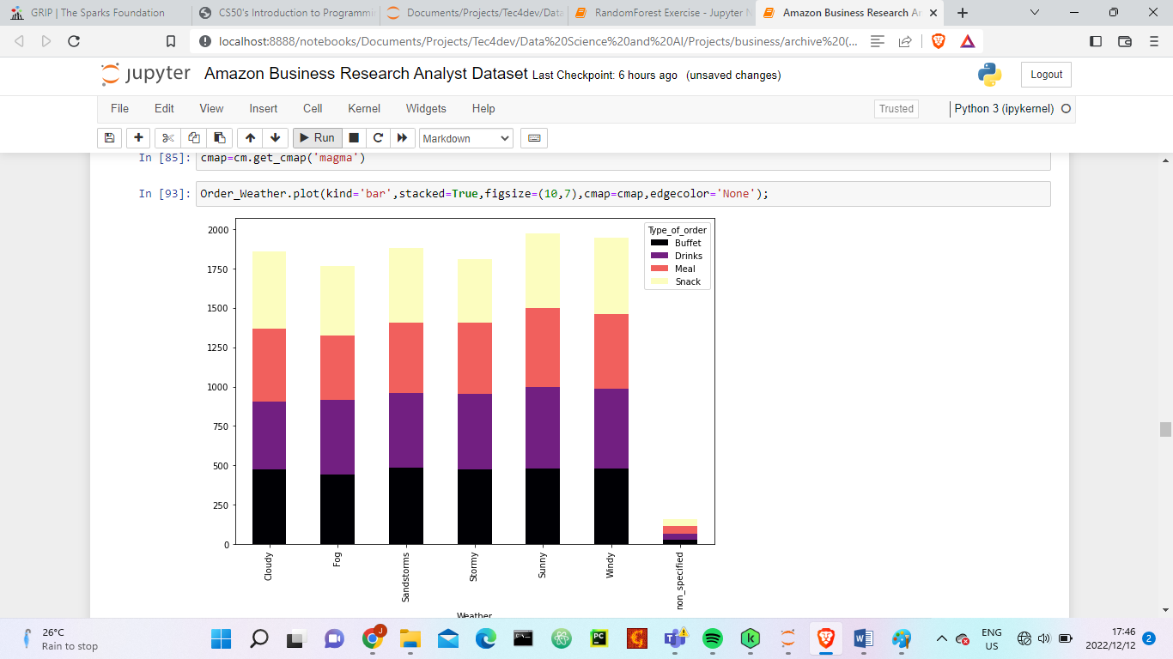
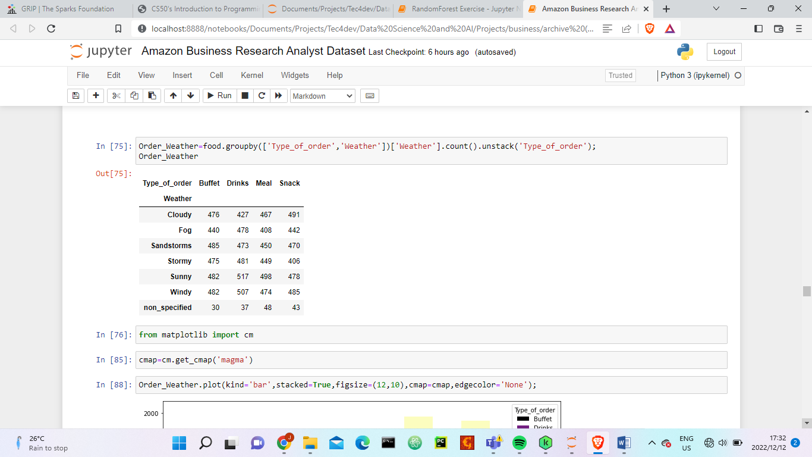
AMAZON BUSINESS RESEARCH ANALYST DATASET
Case in Study; Restaurant

Slide 9
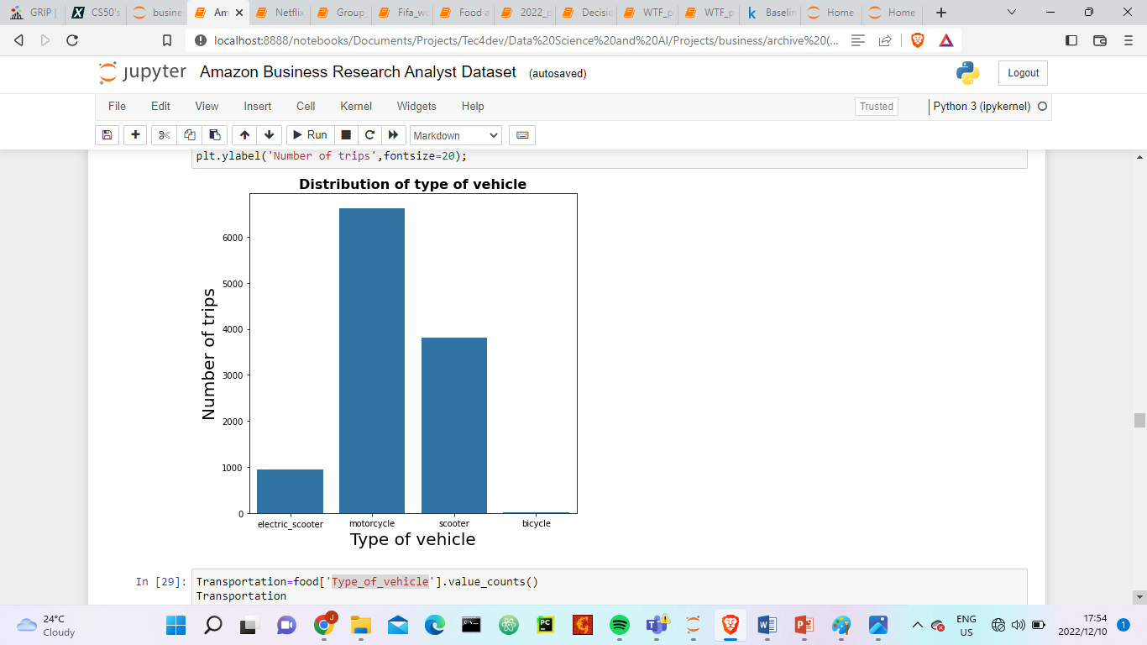
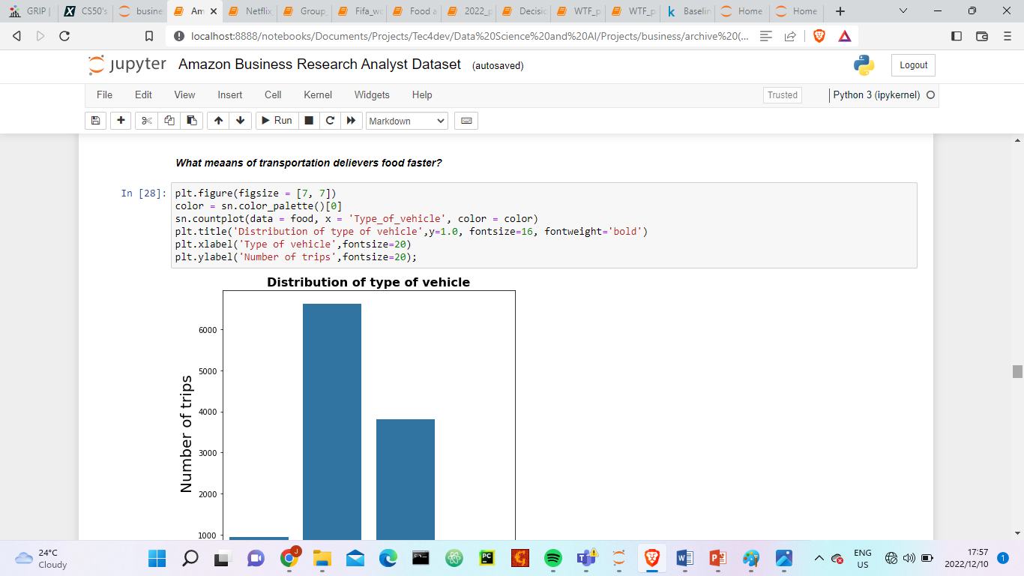
AMAZON BUSINESS RESEARCH ANALYST DATASET
Case in Study; Restaurant

Slide 10
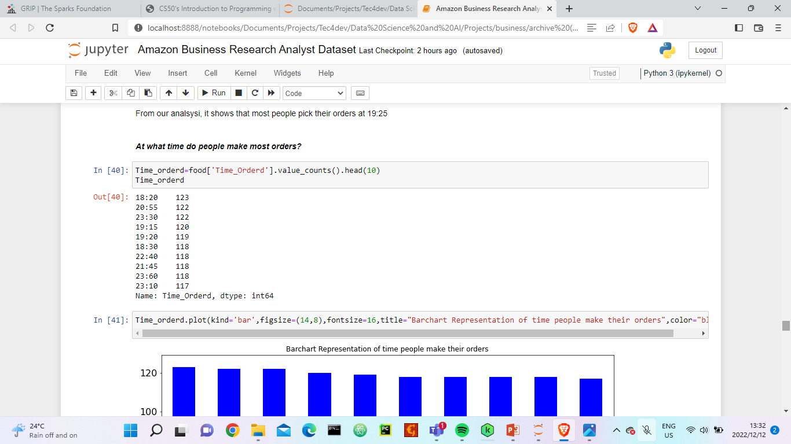
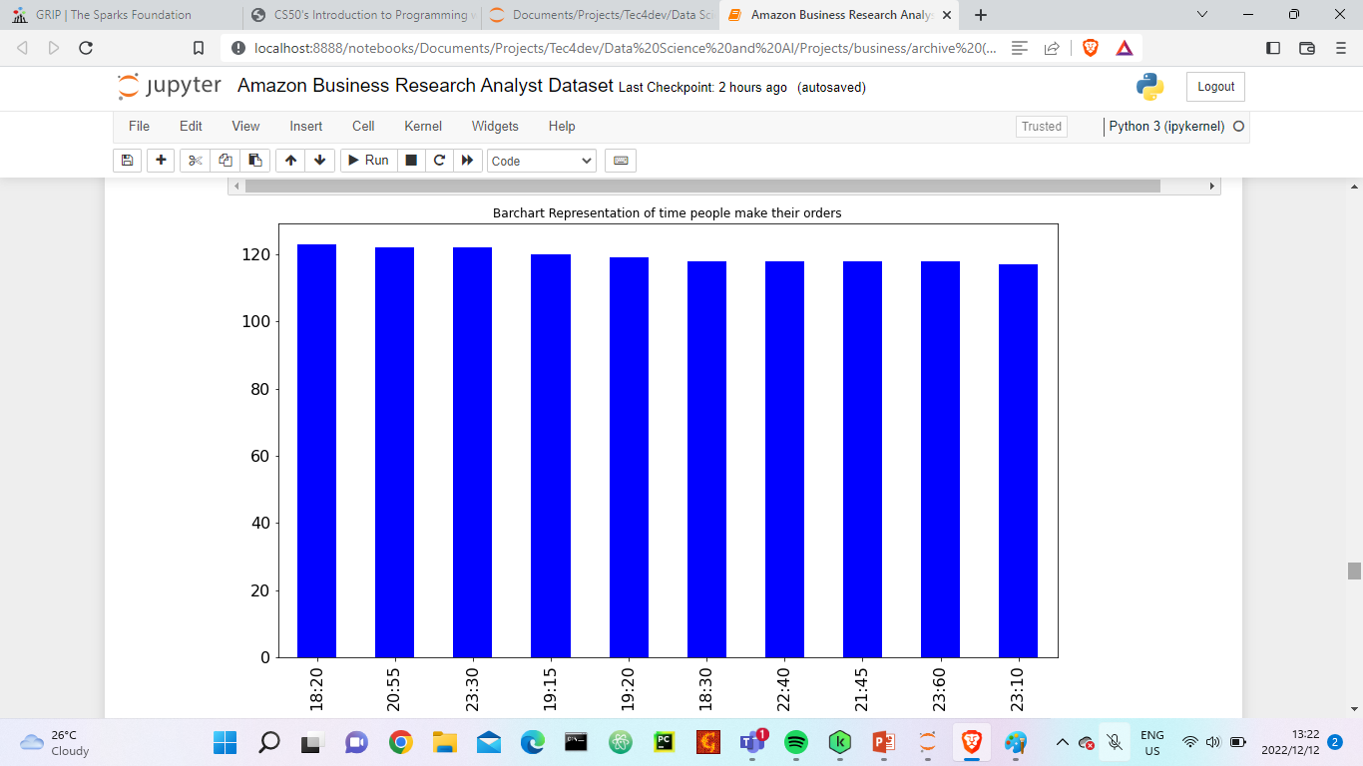
AMAZON BUSINESS RESEARCH ANALYST DATASET
Case in Study; Restaurant

Slide 11
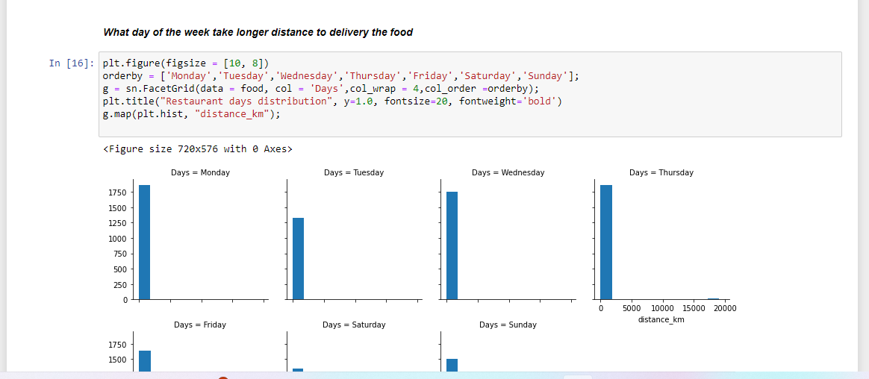
AMAZON BUSINESS RESEARCH ANALYST DATASET
Case in Study; Restaurant

Slide 12
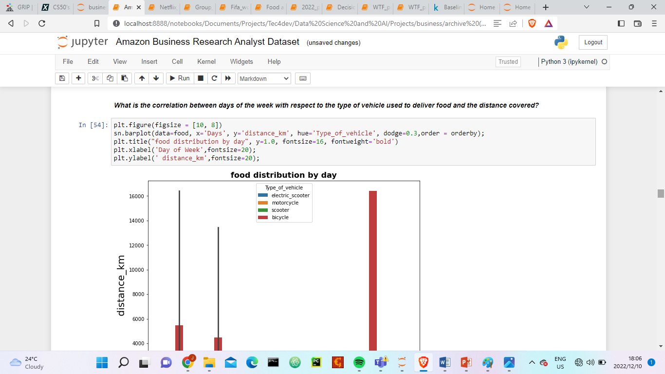
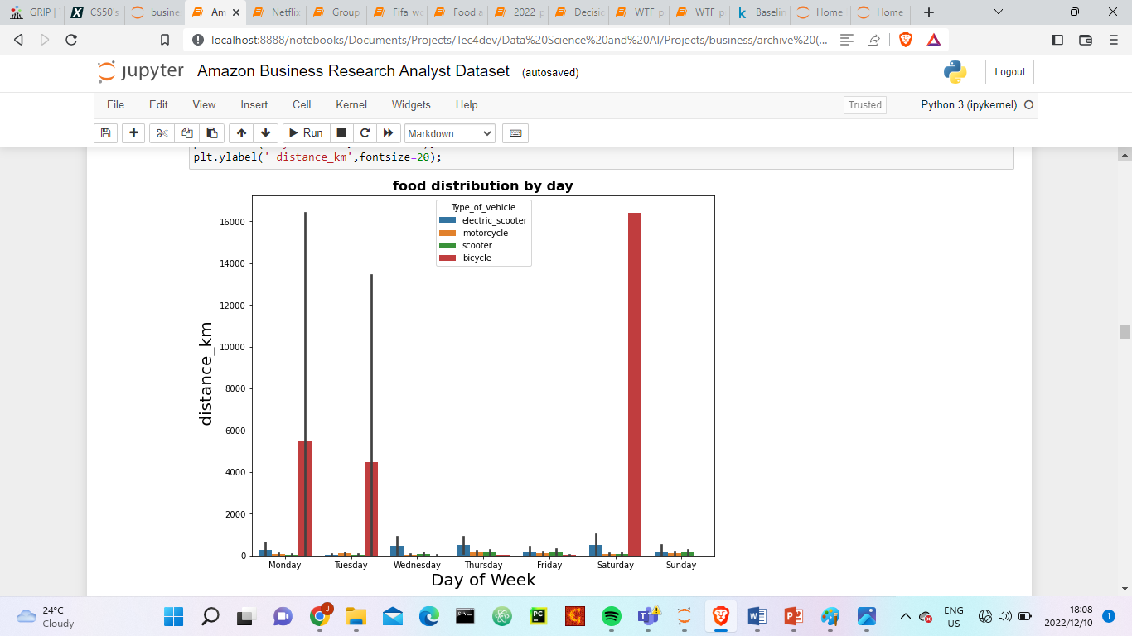
AMAZON BUSINESS RESEARCH ANALYST DATASET
Case in Study; Restaurant
From the diagram above, it shows that the restaurant utilized bicycles the most to cover longer distance on Saturdays

Slide 13
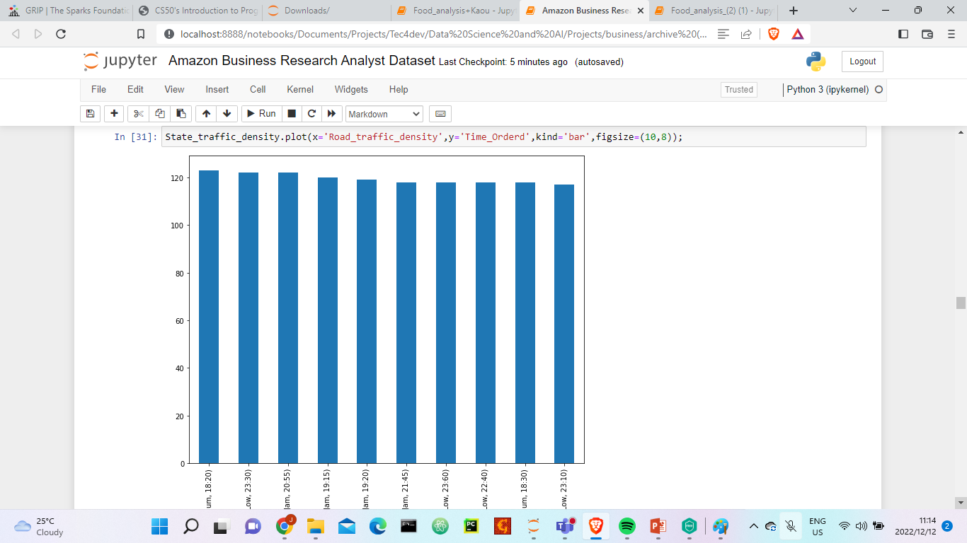
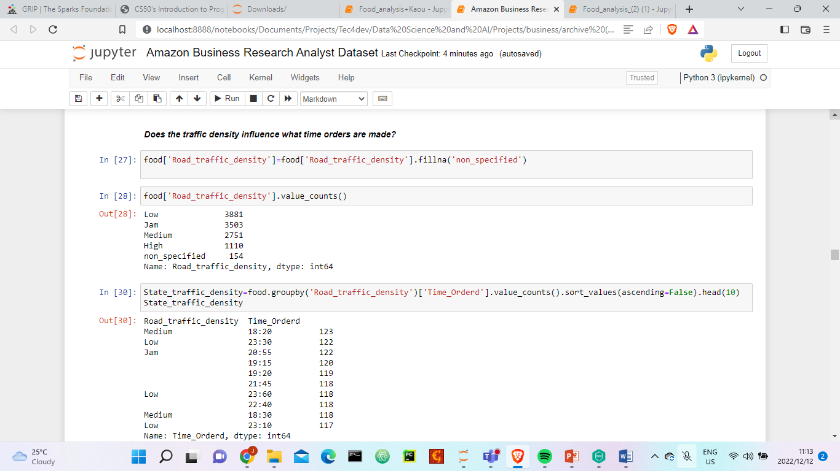
AMAZON BUSINESS RESEARCH ANALYST DATASET
Case in Study; Restaurant
Most of the orders are made after 17h where the traffic density is not high

Slide 14
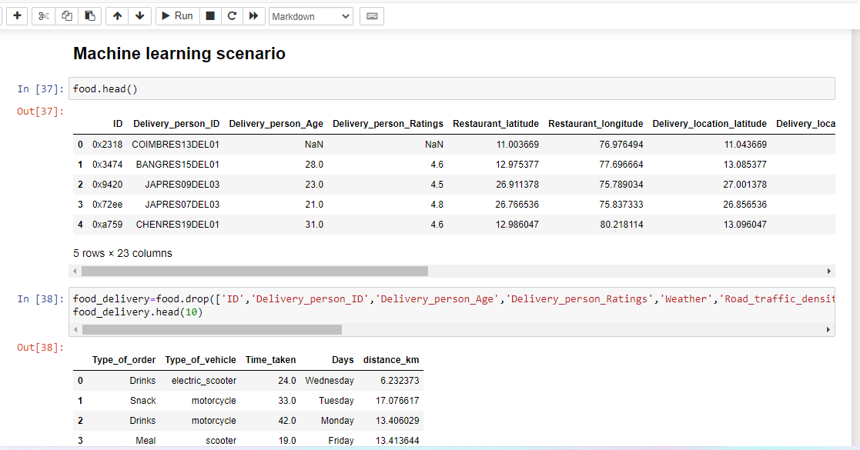
AMAZON BUSINESS RESEARCH ANALYST DATASET
Case in Study; Restaurant

Slide 15
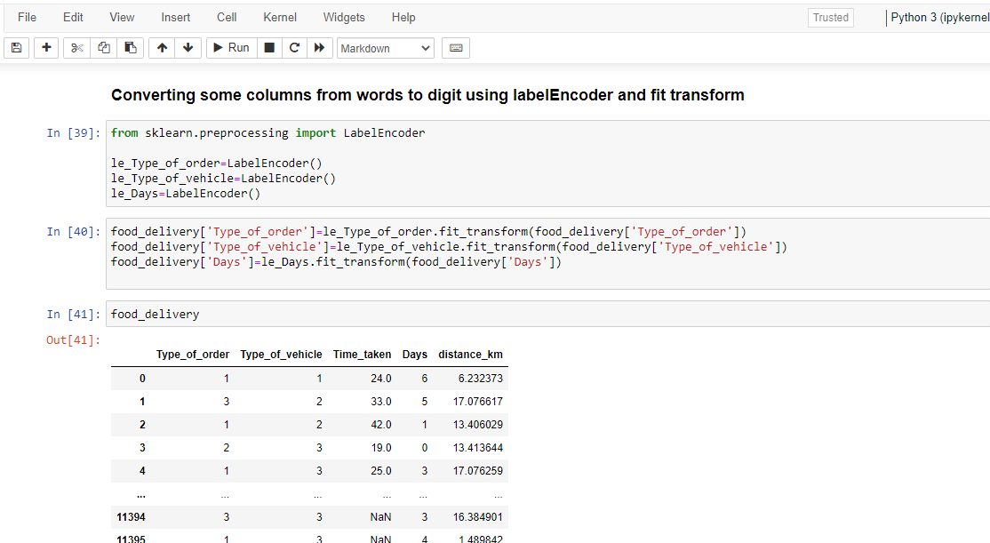
AMAZON BUSINESS RESEARCH ANALYST DATASET
Case in Study; Restaurant

Slide 16
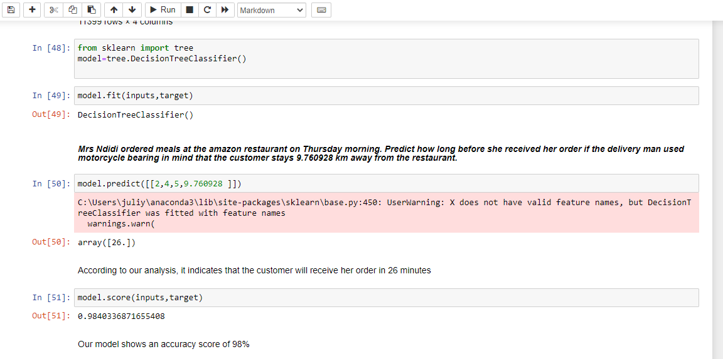
AMAZON BUSINESS RESEARCH ANALYST DATASET
Case in Study; Restaurant

Slide 17
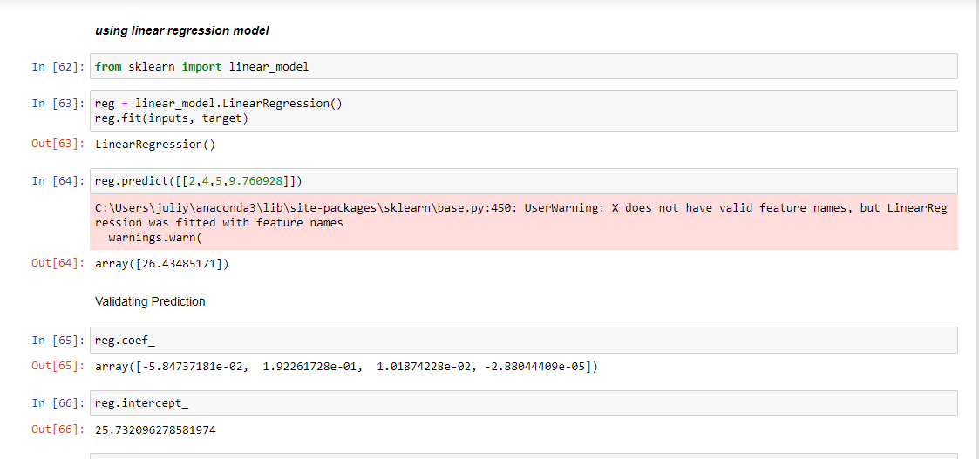
AMAZON BUSINESS RESEARCH ANALYST DATASET
Case in Study; Restaurant

Slide 18
AMAZON BUSINESS RESEARCH ANALYST DATASET
Case in Study; Restaurant
Recommendation;
Having observed that the peak periods where orders are made, were between the hours of 18:20- 0:00 , we recommend that the restaurant management reduce the number of employees who work during daytime and the amount of food prepared during the daytime so as to cut down on expenses, and capitalize on profit making.

Slide 19
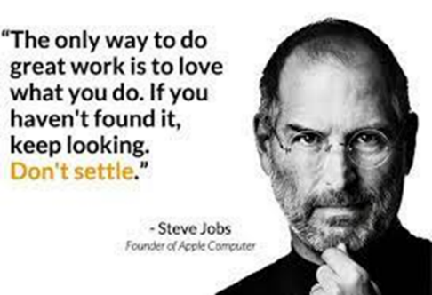
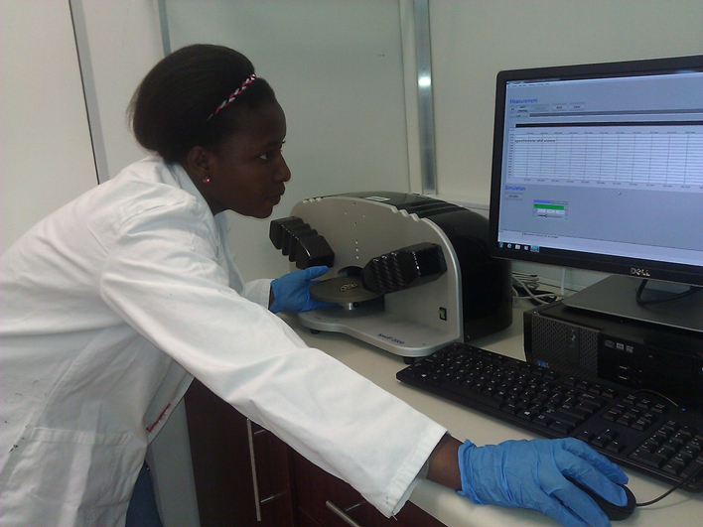
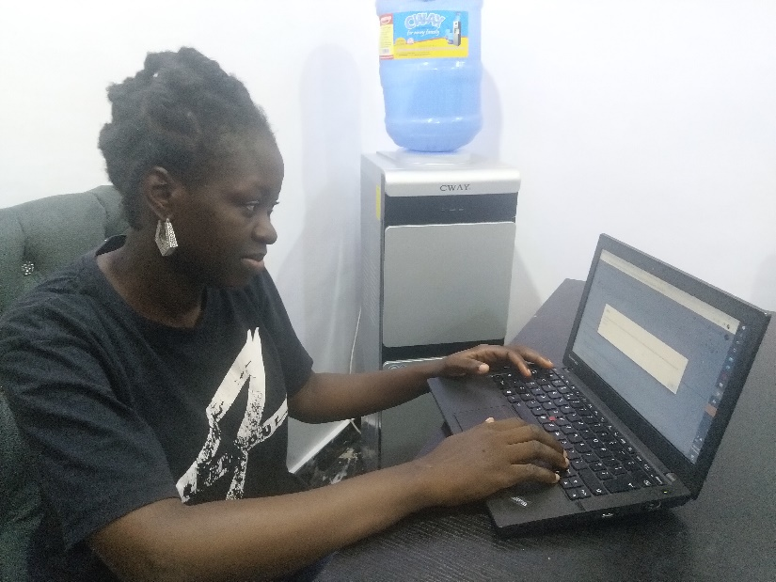
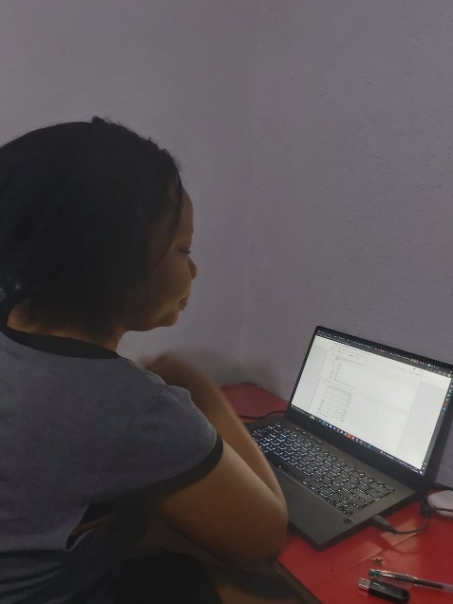
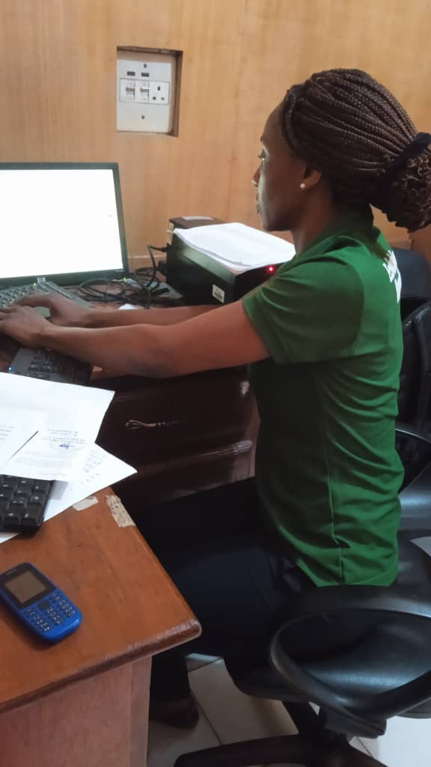
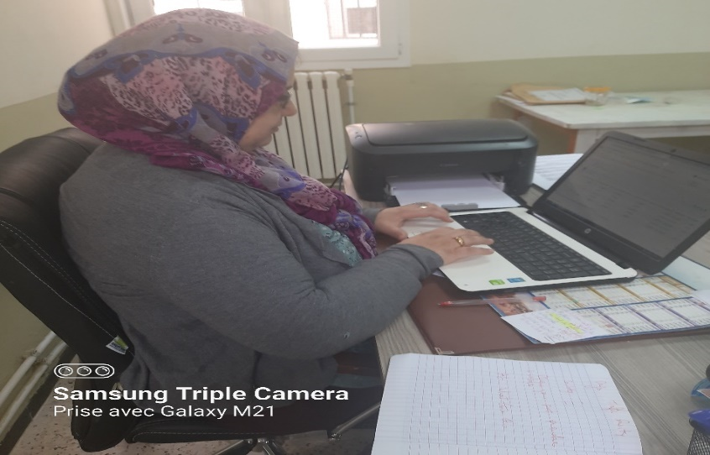
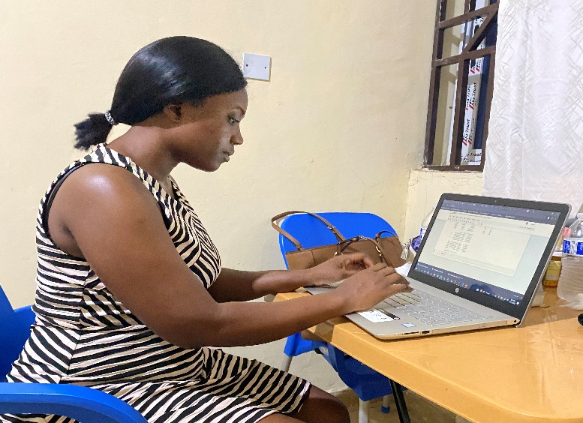
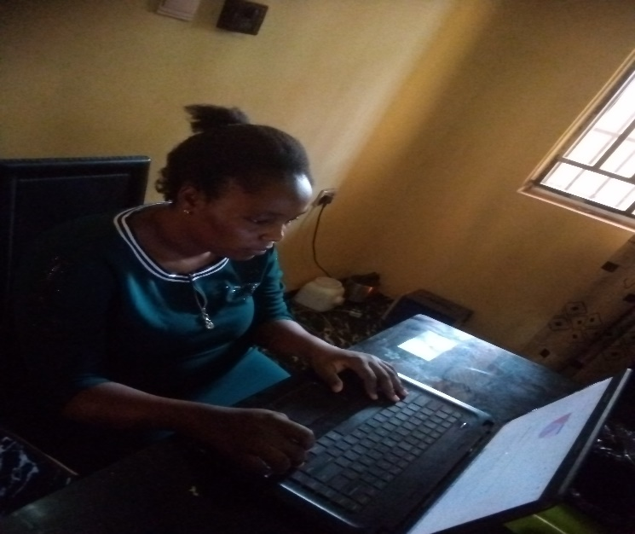
GROUP_5_MEMBERS

Slide 20
Contact Us
Email:jsackeyunisa@gmail.com
Acknowledgement
KOSISOCHUKWU ASHARA

Slide 21


